Slide 1
Introduction to Computation
Fan Cheng Shanghai Jiao Tong University
http://www.cs.sjtu.edu.cn/~chengfan/
chengfan@sjtu.edu.cn
Autumn, 2022
Notes:
Numbers, floating numbers, string, mathematical expressions, print()

Slide 2
Outline
Conditional statement
Loop statement
Function and recursion

Slide 3


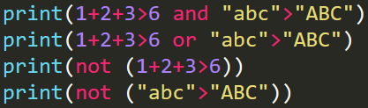

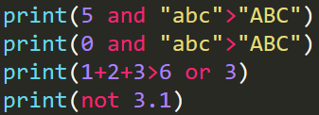

Boolean expression
Recall: 1+2>=3, 8/4 <=3, “abc”!=“ABC”, “a”<“z”
All the expressions above return True or False
A boolean expression is an expression that is either true or false
Operators that can create Boolean expression:
>, <, >=, <=, ==, !=
in, not in (集合)
is, is not (will discuss it later)
True is 1 and False is 0. Both are bool type
Any nonzero number is interpreted as “True”
Logical operators: There are three logical operators: and, or, and not
x and y returns True, if and only if both x and y are True
x or y returns True, if and only if at least one of them are True
not x returns True, if and only if x is False
The priority: not > and > or. Use “()” if you are not sure

Slide 4
Boolean expression
The following values are interpreted as false: False, None, numeric zero of all types, and empty strings and containers (including strings, tuples, lists, dictionaries, sets and frozensets). All other values are interpreted as true.
https://docs.python.org/3.8/reference/expressions.html#boolean-operations
Return value of Boolean expression
The expression x and y first evaluates x; if x is false, its value is returned; otherwise, y is evaluated and the resulting value is returned.
The expression x or y first evaluates x; if x is true, its value is returned; otherwise, y is evaluated and the resulting value is returned.
Note that neither and nor or restrict the value and type they return to False and True, but rather return the last evaluated argument. This is sometimes useful, e.g., if s is a string that should be replaced by a default value if it is empty, the expression s or 'foo' yields the desired value. Because not has to create a new value, it returns a boolean value regardless of the type of its argument (for example, not 'foo' produces False rather than ''.)

Slide 5
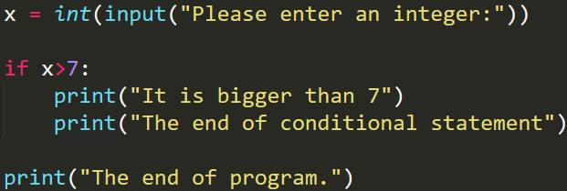
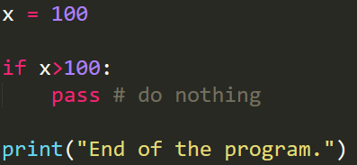
Control statement: if
A control statement is:
if <Boolean expression>: # header
FIRST STATEMENT # body
...
LAST STATEMENT
意思：当xxx条件满足的时候，下面的语句就会被执行
The boolean expression after the if statement is called the condition. If it is True, then the indented statement gets executed. If not, nothing happens
The if statement is made up of a header and a block of statements
The header begins on a new line and ends with a colon (:). The indented statements that follow are called a block. A statement block inside a compound statement is called the body of the statement
There is no limit on the number of statements that can appear in the body of an if statement, but there has to be at least one. You could use pass to skip this issue
Python program is executed from the first line to the last line. Only the Boolean expression is satisfied, the body (indented part) will be executed
Code block and indentation
Execution flow

Slide 6
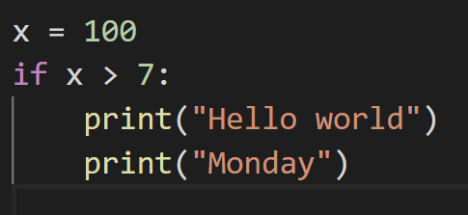
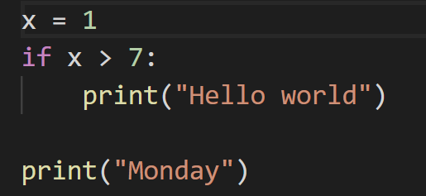


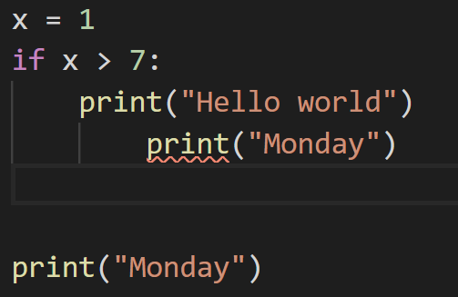
Indent 缩进
缩进具有严格的要求
不可以随便添加
连续的相同缩进的语句构成一个逻辑上的整体
Vscode/sublime: ctrl+shit+p (F1), convert spaces/tabs

Slide 7
if: example
Check whether an integer is even or not
Check whether a year is a leap year (闰年)
Check whether your score is above 60.0 to pass the exam

Slide 8
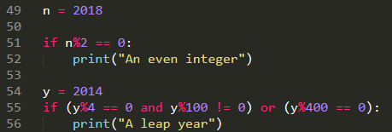

if: example
Check whether an integer is even or not
Check whether a year is a leap year (闰年)
Check whether your score is above 60.0 to pass the exam

Slide 9
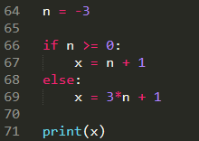

if else
A second form of the if statement is alternative execution, in which there are two possibilities, and the condition determines which one gets executed.
if <Boolean expression>:
do_sth_here #
else:
do_sth_else_here
If the Boolean expression is True, the statement block after “if:” will be executed. Otherwise, the statement block after “else:” will be executed.
如果xxx发生，……
否则，……
Exactly one branch will be executed

Slide 10
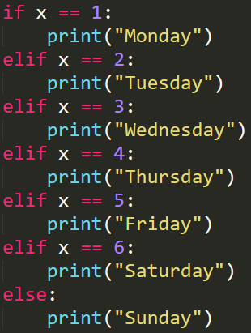
Chained conditionals
In practice, we need to consider more complicated conditions:
if <Boolean expression 1>:
do_sth_here_1
elif <Boolean expression 2>:
do_sth_here_2
……
elif <Boolean expression n>:
do_sth_here_n
else:
do_else_here
The program checks the Boolean expression from 1 to n, if one of them is satisfied, then the statement block will be executed. Or the “else:” statement block is executed
elif is an abbreviation of “else if.” Again, exactly one branch will be executed
There is no limit of the number of elif statements
else is optional (有些语言必须有，python可选)

Slide 11
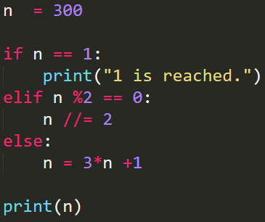
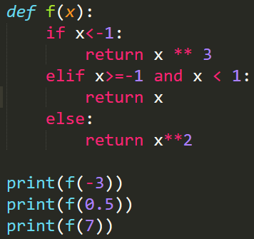


If…elif…else: example
(3n+1 problem) Given a positive integer n, if n is even, then n = n/2; if n is odd, n = 3n+1. Will n =1 after a finite number of steps?
The program will check n ==1 first, then n%2==0. If none is satisfied, it will execute “else:”
(piecewise function)$f\left(x\right)=\left\{\begin{aligned}x^{3}, x<−1 \\ & x, −1≤x<1 \\ x^{2}, x>1\end{aligned}\right.$
When you write a conditional expression, you should check your conditions. Don’t miss any conditions! Or some code will never be executed

Slide 12
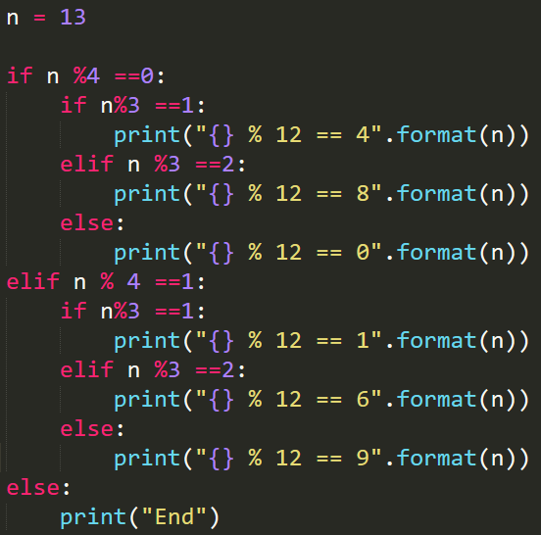
Nested expressions
Expressions can be nested

Slide 13

Loop
从前有座山，山上有座庙，庙里有个老和尚，老和尚在给小和尚讲故事，故事讲的是从前有座山，山上有座庙，庙里有个老和尚，老和尚在给小和尚讲故事，故事讲的是从前有座山，山上有座庙，庙里有个老和尚，老和尚在给小和尚讲故事，故事讲的是从前有座山，山上有座庙，庙里有个老和尚，老和尚在给小和尚讲故事，故事讲的是从前有座山，山上有座庙，庙里有个老和尚，老和尚在给小和尚讲故事，故事讲的是。。。
问题：如何重复输出”hello world”, 3次
答案：反复调用print三次
问题：如果要输出n次呢？n是一个变量
答案：……
1. while statement
2. for statement

Slide 14
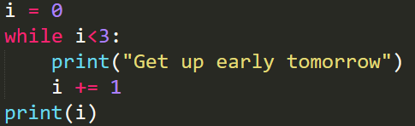
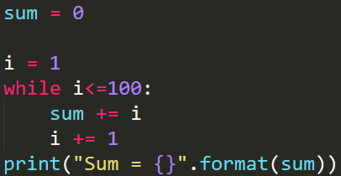
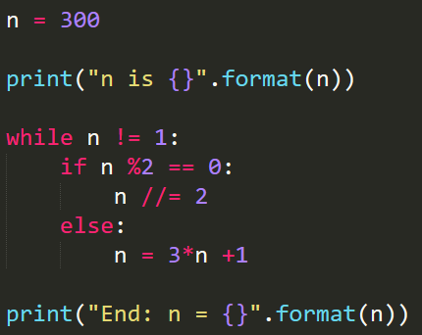
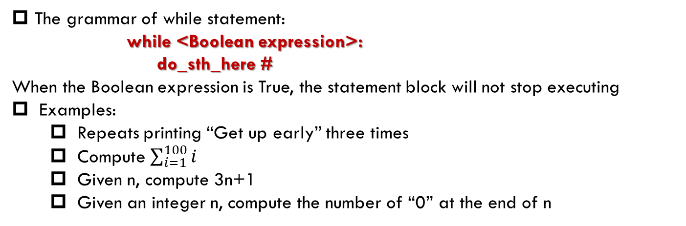
while
The grammar of while statement:
while <Boolean expression>:
do_sth_here #
When the Boolean expression is True, the statement block will not stop executing
Examples:
Repeats printing “Get up early” three times
Compute $\sum_{i=1}^{100}{i}$
Given n, compute 3n+1
Given an integer n, compute the number of “0” at the end of n
The Boolean expressions are not satisfied when i =3, i =101 and n = 1

Slide 15
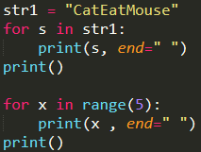

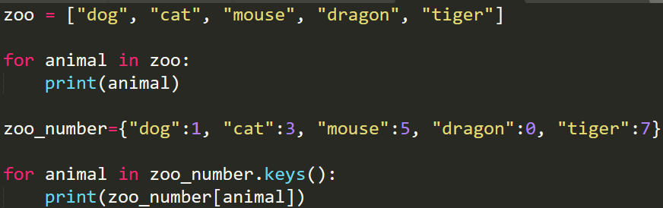

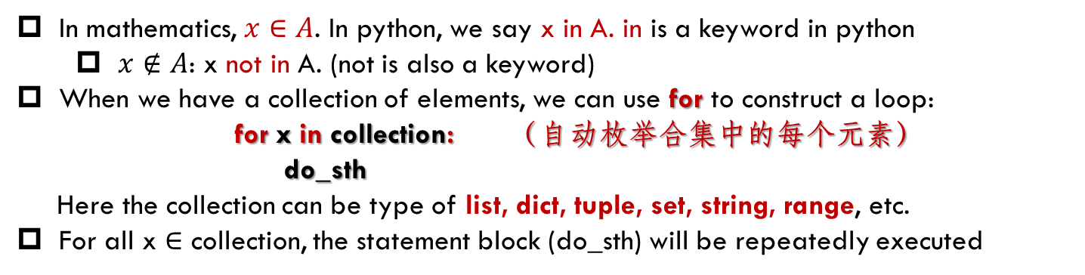
for
In mathematics, $x∈A$. In python, we say x in A. in is a keyword in python
$x∉A$: x not in A. (not is also a keyword)
When we have a collection of elements, we can use for to construct a loop:
for x in collection: （自动枚举合集中的每个元素）
do_sth
Here the collection can be type of list, dict, tuple, set, string, range, etc.
For all x $∈$ collection, the statement block (do_sth) will be repeatedly executed

Slide 16
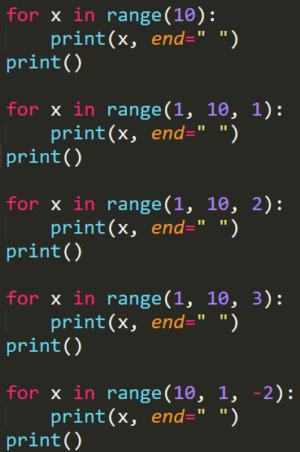
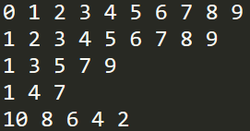
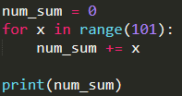

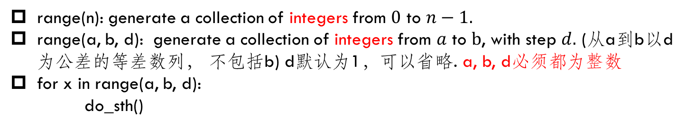
range()
range(n): generate a collection of integers from $0$ to $n−1.$
range(a, b, d): generate a collection of integers from $a$ to $b$, with step $d.$ (从a到b以d为公差的等差数列， 不包括b) d默认为1，可以省略. a, b, d必须都为整数
for x in range(a, b, d):
do_sth()

Slide 17
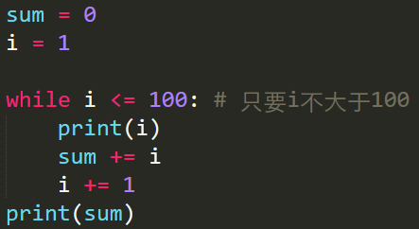
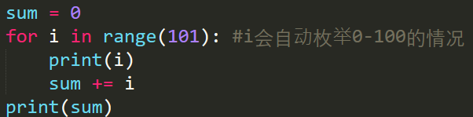

for VS. while
for 自动枚举一个数据中的每个元素
while需要自己枚举每个情况
循环结束的时候，$i$的值有何差异？？？

Slide 18
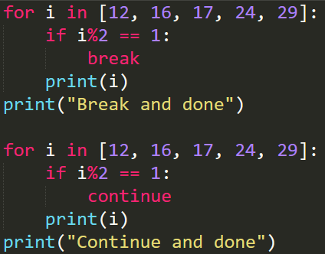
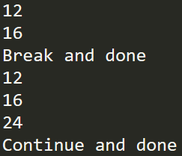
break and continue
For loop statement, we could use break or continue statements to quit the current iteration
break: The break statement is used to immediately leave the body of its loop.
continue: This is a control flow statement that causes the program to immediately skip the processing of the rest of the body of the loop, for the current iteration. But the loop still carries on running for its remaining iterations
Break and continue will quit the current iteration. However, continue will execute the next iteration. Break won’t but quit the whole loop

Slide 19
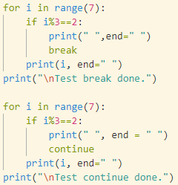
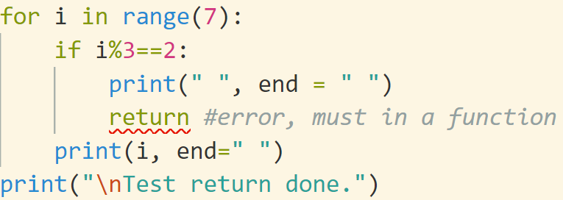
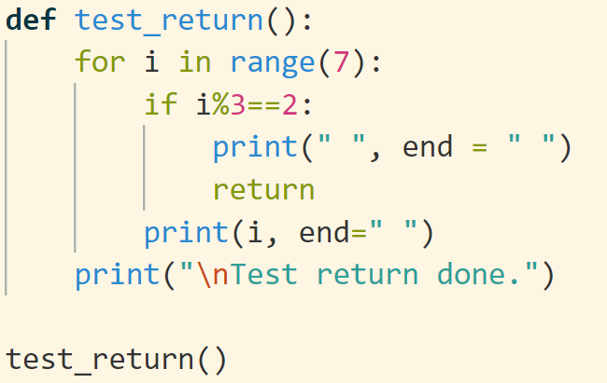


break, continue, return
break: 结束整个循环
continue：结束本轮循环，开始下一轮
return: 结束函数运行，返回（可以不带返回值）

Slide 20
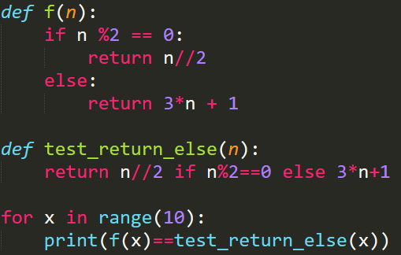

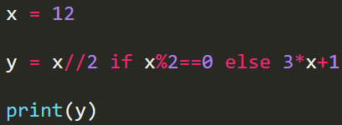
return … if … else …
return value1 if condition else value2
A convenient usage of return
Equivalent
if condition:
return value1
else:
return valuel2

Slide 21
for/while - else
for/while loops also have an else clause which most of us are unfamiliar with.
The else clause executes after the loop completes normally.
This means that the loop did not encounter a break statement.
The common construct is to run a loop and search for an item.
If the item is found, we break out of the loop using the break statement. There are two scenarios in which the loop may end.
The first one is when the item is found and break is encountered.
The second scenario is that the loop ends without encountering a break statement.
Now we may want to know which one of these is the reason for a loop’s completion.
One method is to set a flag and then check it once the loop ends. Another is to use the else clause.
https://book.pythontips.com/en/latest/for_-_else.html

Slide 22
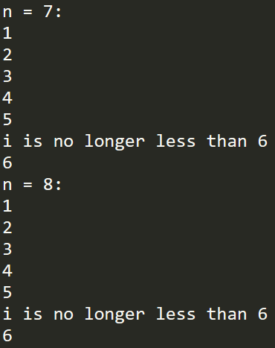
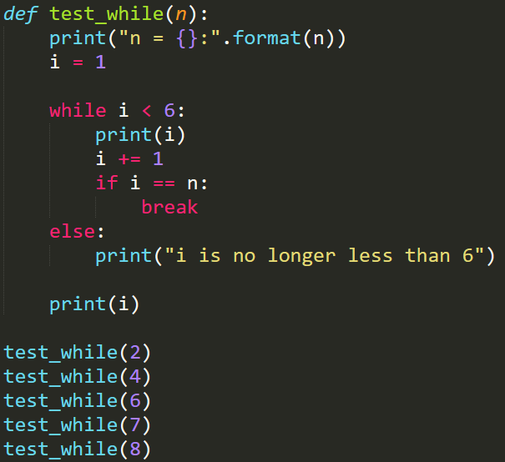
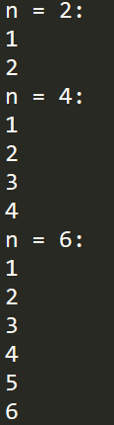
如果不用else：
在循环结束后加一个判断：if i==6

Slide 23
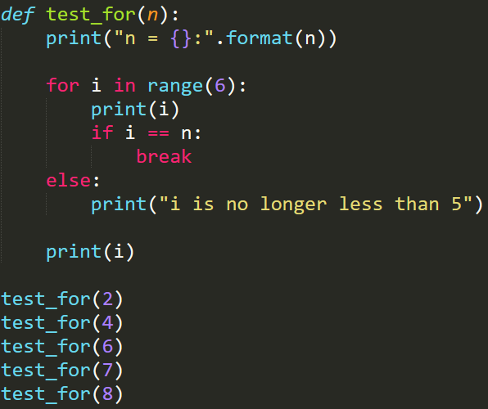
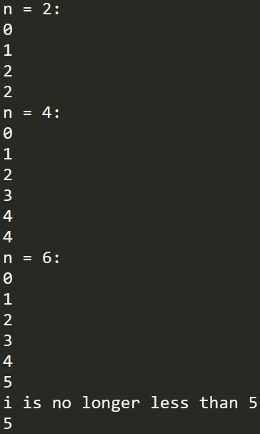
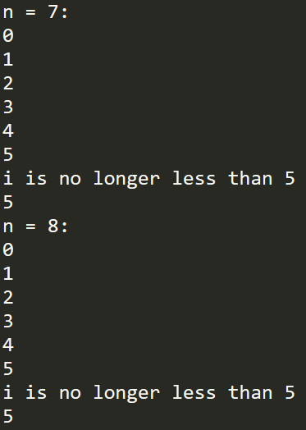
不要用没有完全掌握的语法
如果不用else：
在循环结束后加一个判断
for要注意，结束的情况和while不同

Slide 24
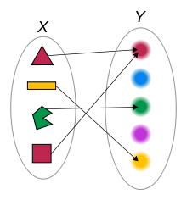
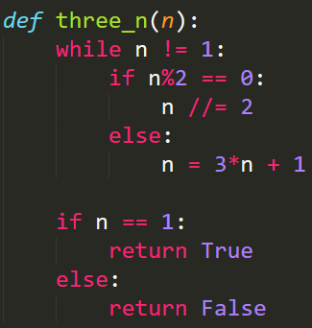
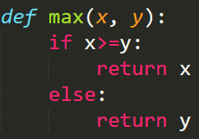
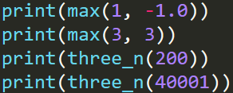

Function
Functions are a piece of code can be called (调用)
You have to create a function before you can execute it. In other words, the function definition must be given before the first time it is called
Function calls: name, parameters, return value
Function definition: name, parameters, return value
def function_name(param1, …, paramn):
do_sth_here
In most situation, no interference between users when called the same function simultaneously
Function can be reused. 书写一次，永久受益

Slide 25
Flow of execution
When the function is defined, this piece of code won’t be executed until it is called somewhere
Function definitions do not alter the flow of execution (the order in which statements are executed) of the program, but remember that statements inside the function are not executed until the function is called.
You can define one function inside another. In this case, the inner definition isn’t executed until the outer function is called.
If there is call statement in the flow of execution, instead of going to the next statement, the flow jumps to the first line of the called function, executes all the statements there, and then comes back to pick up where it left off.
Therefore, when you read a program, don’t read from top to bottom. Instead, follow the flow of execution.

Slide 26
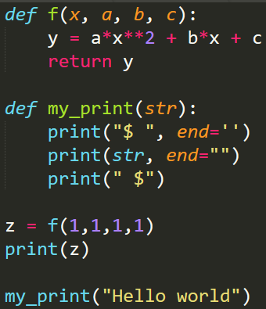
Function call in python
Copy from lecture 3
系统定义的函数(譬如print(), int())和用户定义的函数(f(x,a,b,c))，定义的时候，函数本身并不会被执行，只有调用的时候才会执行
函数被调用的时候（譬如我们调用print()(或者f(1,1,1,1))），程序会跳转到被调用函数的定义，从函数头开始执行
如果函数有参数，那么我们调用的时候参数会被传到函数头的参数。也就是函数头的参数会被初始化赋值
函数体的语句会一条一条的顺序执行，直到结束。函数运行结束后，系统会从函数体跳转回到程序原来调用函数的地方。对于需要返回值的函数, 系统通过return 把返回值返回给调用者；对于没有返回值的函数，系统会自动返回
对于有return的函数，函数调用可以作为一个值来使用。没有return的，系统会默认返回None，也就是空
return会把程序运行的地点从函数体转移回函数调用的地方。无论return后面有没有语句，都不会被执行了。
return命令的效果就是从函数的运行返回到函数调用的地方。如果需要返回一个计算值，那么用return xxxx; 如果不需要返回计算值，可以直接一个return
一般情况下，函数的定义中使用的变量，不会对外面定义的变量有干涉：因为他们属于不同的势力范围
首先，我们定义了两个函数f和my_print，函数定义本身并不会被执行。我们调用f(1,1,1,1)的时候，系统会跳转到f的定义的部分(也就是def f)，开始运行：首先参数x,a,b,c会被赋值为1,1,1,1；然后函数体中的语句会被执行，直到计算出y。通过return y语句，系统跳转回原来的语句z=f(1,1,1,1), 并且将return 回来的y赋给了z。下面是一个函数调用更复杂的例子：函数调用了四次，return了四个值

Slide 27
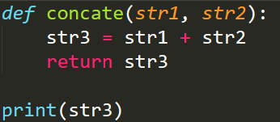
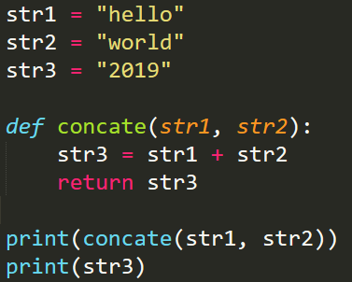

Locality(局部性)
Variables and parameters are local （互不干涉）
When you create a local variable inside a function, it only exists inside the function, and you cannot use it outside:
Parameters are also local
str3 can be used only inside the function

Slide 28
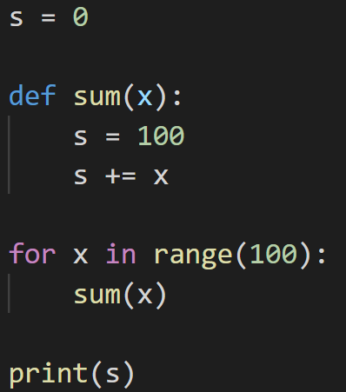
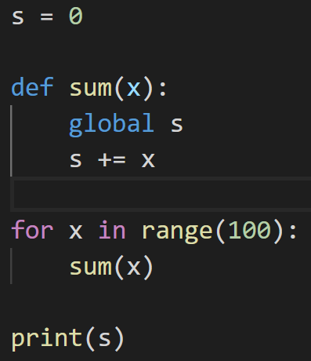



global: break locality
global (全局): 如果要在函数内修改函数外部的某个变量，可以在前面加global关键字
可以在函数内部，直接使用外部的变量，如果不修改这个变量

Slide 29
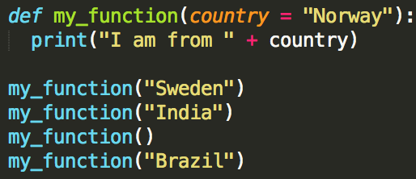
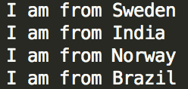


Default parameter (默认参数)
The following example shows how to use a default parameter value.
If we call the function without parameter, it uses the default value:
Passing via keyword. In general, we need to align parameters by order. We can avoid it by passing via keyword
In this example, we use assign the parameters the values. It can help us get rid of the mistakes of misalignment
推荐使用：不犯错误的唯一办法是把错误本身消灭掉

Slide 30




*args
If * appeared before a function parameter, then it can accept any number of variables. (In convention, we use * args)

Slide 31




Indentation (缩进)
缩进用来表示命令属于哪个语句块(block)，相同的缩进就表明在一个语句块
Python中，if, while, for, def, class 等语句会和下面的语句语句块构成一个整体。缩进会表明这个这条语句是不是和上面的语句头构成一个整体。

Slide 32




Indentation: common errors
Don’t use “Tab” and “whitespace” simultaneously
Abide by the rule of indentation for each statement strictly
Don’t add any extra whitespace before indentation
“Whitespace” is preferred than “Tab”

Slide 33

Type Hint：类型提示 (Python 3.5+)
In Python, we don’t need to specify the types of arguments and return values as C++ and Java do
However, it is convenient to specify the types if possible
You need to install an extension
pip install mypy
>>mypy .\course_code.py
mypy extension in vscode
https://mypy.readthedocs.io/en/stable/cheat_sheet_py3.html

Slide 34
Programming with style
Readability is very important to programmers, since in practice programs are read and modified far more often than they are written.
A recommended programming style for Python is shown as follows:
use 4 spaces for indentation
imports should go at the top of the file
separate function definitions with two blank lines
keep function definitions together
keep top level statements, including function calls, together at the bottom of the program
More programming styles for Python can be obtained from the website http://www.python.org/dev/peps/pep-0008/ (Style Guide for Python Code)

Slide 35
Exercise
Given integers a, b, c, return the middle one
Given a positive integer n, count how many zeros at its end
The Hamming distance between two integers is the number of positions at which the corresponding bits are different (即对应的二进制表示，有多少位不同)
Given two integers, calculate the Hamming distance.
Input: x=1, y = 4
Output: 2

